Slide 1

IT-648: IT Risk Management
Week 11
Sonja Streuber

Slide 2
Agenda
# | Topic | Reading | Due 11:59 pm CST on Blackboard
11 | Shell Scripting: Output redirection, Text manipulation, Variables, Conditionals, User input, Loops | Agrawal 10 Other materials on Blackboard | W: Post F: Responses S: LAB_11

Slide 3
Chapter 10
Shell Scripting

Slide 4
Overview
By the end of this week, you will be able to:
How to write a simple BASH shell script
Use of common programming elements (variables, loops, etc)
How to handle user interaction
How to use common UNIX tools to parse and manipulate text files

Slide 5
Introduction
Shell scripts are used for automating processes throughout a computer
Basic knowledge of shell scripting necessary for all system administrators
Traditionally on Unix systems, now also Windows (PowerShell)
Use for automation of processes that would be too time-consuming to do manually or need to be repeated in the future
Script vs. program
Scripts don’t have to be compiled into a binary file to be run
Script interpreted and converted into necessary binary code at run-time
Philosophy: Use multiple small programs in sequence instead of a single, complex application
Several popular scripting languages in use
PHP, Python, Ruby

Slide 6
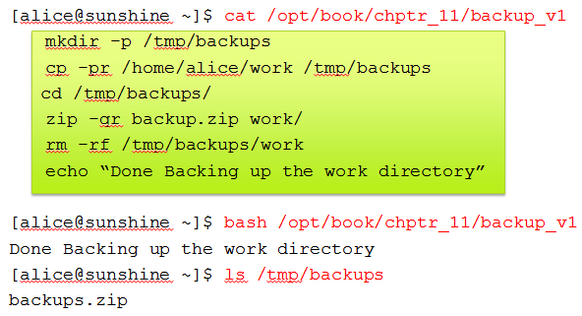
Script basics
[alice@sunshine ~]$ cat /opt/book/chptr_11/backup_v1
mkdir -p /tmp/backups
cp -pr /home/alice/work /tmp/backups
cd /tmp/backups/
zip -qr backup.zip work/
rm -rf /tmp/backups/work
echo “Done Backing up the work directory”
[alice@sunshine ~]$ bash /opt/book/chptr_11/backup_v1
Done Backing up the work directory
[alice@sunshine ~]$ ls /tmp/backups
backups.zip
What is going on in backup_v1?
Create a folder in the /tmp directory to save backup file
Copy files from Alice’s work folder into a sub-folder
Navigate to the backup folder
Zip up the contents of the work sub-folder to backup.zip
Remove sub-folder
Alert user of successful completion
Net result: Contents of /home/alice/work backed up as /tmp/backup/backup.zip
We use the bash command with the file as argument: Runs the script
We use the ls command to confirm successful execution of the script

Slide 7
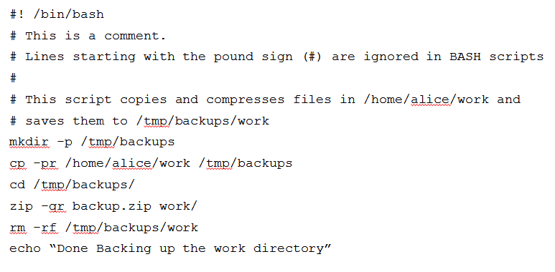
Script basics – contd.
No need to type bash anymore
Comments: Contain meta-information: Script author, modification date, bug fix reference number, notes about how script works
[alice@sunshine ~]$ /opt/book/chptr_11/backup_v2
Done Backing up the work directory

Slide 8
Output piping - mini scripts
Alternate way to write quick scripts
Use | operator (pipe)
Symbol above the Enter key on most keyboards
[alice@sunshine ~]$ ls -l /usr/bin | grep gnome | head -3
-rwxr-xr-x. 1 root root 37070 Mar 20 2012 gnome-about
-rwxr-xr-x. 1 root root 88944 Jun 25 10:29 gnome-about-me
-rwxr-xr-x. 1 root root 233664 Jun 25 10:29 gnome-appearance-properties
Output of ls command sent as input to grep command
Output of grep command sent as input to head command
Out of head command
Displayed on default stream
Terminal window

Slide 9
Output redirection
Save the output to a file with redirection operator
> : Creates file and writes output
>>: Appends output to end of file
[alice@sunshine ~]$ ls -l /usr/bin | grep gnome | head -3 > /tmp/example.txt
[alice@sunshine ~]$ cat /tmp/example.txt
-rwxr-xr-x. 1 root root 37070 Mar 20 2012 gnome-about
-rwxr-xr-x. 1 root root 88944 Jun 25 10:29 gnome-about-me
-rwxr-xr-x. 1 root root 233664 Jun 25 10:29 gnome-appearance-properties
[alice@sunshine ~]$ ls -l /usr/bin | grep gnome | head -5 >> /tmp/example.txt
[alice@sunshine ~]$ cat /tmp/example.txt
-rwxr-xr-x. 1 root root 37070 Mar 20 2012 gnome-about
-rwxr-xr-x. 1 root root 88944 Jun 25 10:29 gnome-about-me
-rwxr-xr-x. 1 root root 233664 Jun 25 10:29 gnome-appearance-properties
-rwxr-xr-x. 1 root root 37070 Mar 20 2012 gnome-about
-rwxr-xr-x. 1 root root 88944 Jun 25 10:29 gnome-about-me
-rwxr-xr-x. 1 root root 233664 Jun 25 10:29 gnome-appearance-properties

Slide 10
Text manipulation
One of the core scripting activities
Most log files, conf files formatted to facilitate text processing
‘Swiss-army knife’ of text manipulation
cut: Deals with columnar data using some form of separator
Tab, comma, space to delimit each column in the dataset
sort: Sorts lines of a text file
uniq: Picks out only unique information
tr: Substitutes specified list of characters with a second set of characters

Slide 11
cut command
Parse each line of the data file & extract only the column you need
Example: Extract email address from contacts spreadsheet
[alice@sunshine ~]$ head -3 /opt/book/chptr_11/users.csv
Ian,Cook,ian.cook,ian.cook@sunshine.edu
Christine,Riggs,christine.riggs,christine.riggs@sunshine.edu
Lindsay,Fishbein,lindsay.fishbein,lindsay.fishbein@sunshine.edu
[alice@sunshine ~]$ cut -d, -f4 /opt/book/chptr_11/users.csv
ian.cook@sunshine.edu
christine.riggs@sunshine.edu
lindsay.fishbein@sunshine.edu

Slide 12
cut – contd.
Can return multiple columns
[alice@sunshine ~]$ cut -d, -f1,2,4 /opt/book/chptr_11/users.csv | grep john
John,Jayavelu,john.jayavelu@sunshine.edu
Jennifer,Johnson,jennifer.johnson@sunshine.edu
John,Altier,john.altier@sunshine.edu
Example used pipe (|) operator
To filter output with grep
Search for lines with string “john”

Slide 13
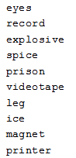
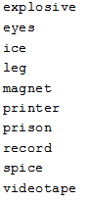
sort
[alice@sunshine ~]$ cat /opt/book/chptr_11/words.txt
[alice@sunshine ~]$ sort /opt/book/chptr_11/words.txt

Slide 14
sort – contd.
-n flag used with numeric data
[alice@sunshine ~]$ sort /opt/book/chptr_11/numbers.txt
1
1002
1234567
356
4
8675309
99
[alice@sunshine ~]$ sort -n /opt/book/chptr_11/numbers.txt
1
4
99
356
1002
1234567
8675309

Slide 15
uniq
Removes duplicate lines from a text file
uniq only searches adjacent lines to find duplicates → input must be sorted first
[alice@sunshine ~]$ cat /opt/book/chptr_11/duplicates.txt
apple
banana
orange
orange
kiwi
banana
kiwi
apple
[alice@sunshine ~]$ sort /opt/book/chptr_11/duplicates.txt | uniq
apple
banana
kiwi
orange

Slide 16
tr
To substitute x, y and z for all occurrences of a, b and c in a text file
[alice@sunshine ~]$ cat /opt/book/chptr_11/original.txt
The quick brown fox jumps over the lazy dog
[alice@sunshine ~]$ cat /opt/book/chptr_11/original.txt | tr “abc” “xyz”
The quizk yrown fox jumps over the lxzy dog
[alice@sunshine ~]$ cat /opt/book/chptr_11/original.txt | tr -d “abc”
The quik rown fox jumps over the lzy dog
A more commonly used function of tr is to convert lower case text to uppercase and vise versa:
[alice@sunshine ~]$ cat /opt/book/chptr_11/original.txt | tr “[:lower:]” “[:upper:]”
THE QUICK BROWN FOX JUMPS OVER THE LAZY DOG
[:lower:] and [:upper:] are character sets
Quick way to specify all lower and upper case letters respectively
Please see the manual page for tr for full list of available character sets
man tr

Slide 17
Variables
Representation of piece of data stored in computer’s memory
Number, filename, text string, etc
To create a new variable
Simply supply variable name
And data it represents: value
[alice@sunshine ~]$ myVariable=20
[alice@sunshine ~]$ echo $myVariable
20
2. Can also assign text as a variable’s value
[alice@sunshine ~]$ hello=“Hello World”
[alice@sunshine ~]$ world=$hello
[alice@sunshine ~]$ echo $hello ➔ Hello World
[alice@sunshine ~]$ echo $world ➔ Hello World
3. Command expansion
[alice@sunshine ~]$ now=$(date)
[alice@sunshine ~]$ echo $now ➔ Wed Dec 19 10:41:40 EST 2012
No spaces before or after the = when assigning a value
Content of Variable is called with $

Slide 18
Variables – contd.
Basic integer arithmetic
$(( )) construct
Arithmetic expansion
[alice@sunshine ~]$ myVariable=20
[alice@sunshine ~]$ myBigVariable=$(( $myVariable * 100 ))
[alice@sunshine ~]$ echo myBigVariable
2000
[alice@sunshine ~]$ echo $(( $myBigVariable + 1 ))
2001

Slide 19
Variables – quoting
Enclosing a variable in single quotes (‘ ’) causes variable name to be used literally iInstead of substituting variable’s value
#! /bin/bash
name=Alice
echo “My name is $name and the date is $(date +%m-%d-%Y)”
echo 'My name is $name date is $(date +%m-%d-%Y)'
[alice@sunshine ~]$ /opt/book/chptr_11/quoting
My name is Alice and the date is 12-19-2012
My name is $name and the date is $(date +%m-%d-%Y)
Single quotes in second line printed literal variable names
Current date was substituted for $(date +%m-%d-%Y)
Commands enclosed in $( ) are run each time they are encountered in a script (Value is determined dynamically)

Slide 20
Environment variables
Variables created automatically on login or starting new terminal window
Default values and user preferences for current terminal session
Viewed with env command
[alice@sunshine ~]$ env
HOSTNAME=sunshine.edu
SHELL=/bin/bash
USER=alice
PATH=(/usr/lib/qt-3.3/bin:/usr/local/bin:/usr/bin:/bin:/usr/local/sbin:/usr/sbin:/sbin:/home/alice/bin
...
PWD=/home/alice
TERM=xterm

Slide 21
Environment variables in shell scripts
Environment variables can be used in shell scripts and commands just like regular variables
Created automatically by BASH
Dynamic output based on user executing the script
[alice@sunshine ~]$ echo “My name is $USER and my current directory is $PWD”
My name is alice and my current directory is /home/alice
[alice@sunshine ~]$ cat /opt/book/chptr_11/env_variable_example
#! /bin/bash
echo “Hello $USER”
echo “You are calling this program from $PWD”
echo “Your home directory is $HOME”

Slide 22
Environment variables in shell scripts
Output when the user alice runs this script
[alice@sunshine Desktop]$ /opt/book/chptr_11/env_variable_example
Hello alice
You are calling this program from /home/alice/Desktop
Your home directory is /home/alice
Output when user bob runs it
[bob@sunshine tmp]$ /opt/book/chptr_11/env_variable_example
Hello bob
You are calling this program from /tmp
Your home directory is /home/bob

Slide 23
Built-in variables
BASH also defines several variables with useful values
In addition to environment variables
Collectively referred to as built-in variables
Provide wide array of small functions, e.g.
Reporting on the type of hardware the server is running
Returning the status of the last command issued
Dozens of built-in variables to choose from
#! /bin/bash
echo “This script is executing with process ID: $$”
echo “OS: $OSTYPE Hardware: $MACHTYPE”
echo “This is he current date and time:”
date
echo “The exit value from date was $?”
echo “This command should fail:”
ls -l NoFile
echo “The exit value was $?”
echo “Wait 2 seconds”
sleep 2
echo “Here are 3 random numbers:”
echo $RANDOM
echo $RANDOM
echo $RANDOM
echo “Wait 3 seconds”
sleep 3
echo “This script has run for $SECONDS seconds”

Slide 24
Built-in variables example
[alice@sunshine ~]$ /opt/book/chptr_11/builtin_variable_example
This script is executing with process ID: 10380
OS: linux-gnu Hardware: i386-redhat-linux-gnu
This is the current date and time:
Wed Dec 19 11:41:40 EST 2012
The exit value from date was 0
This command should fail:
ls: cannot access NoFile: No such file or directory
The exit value was 2
Wait 2 seconds
Here are 3 random numbers:
10549
319
20535
Wait 3 seconds
This script has run for 5 seconds

Slide 25
Conditionals
BASH provides constructs that test a set of given conditions and act based on the result of the test
Like any other programming language
If/ then
If/ then/ else
If/ then/ elif
Example
#! /bin/bash
if [ “$USER” = “alice” ]
then
echo “Good Morning, Alice!”
fi
Mandatory space between the if and the square brackets
Different operators for different data types
String comparison: =
Numerical comparison: -eq

Slide 26
Conditionals – example
#! /bin/bash
guess=2
number=$(( ( $RANDOM % 100 ) + 1 ))
#Is the guess correct?
if [ $guess -eq $number ]
then
echo “Correct Guess: The number is $number”
else
# Is the guess high?
if [ $number -lt $guess ]
then
echo “Guess lower: The number is less than $guess”
fi
# Is the guess low?
if [ $number -gt $guess ]
then
echo “Guess higher: The number is greater than $guess”
fi
fi
[alice@sunshine ~]$ /opt/book/chptr_11/number_guess_v2
Guess higher: The number is greater than 2

Slide 27
User input
How to accept user input
So far, we have created variable values within the script
E.g. $RANDOM
What if you want values that are supplied by the user
Two ways to accept input from the user
Command line arguments
Like other command arguments we have used so far
Automatically stored in special variables when the program executes
Variables named in the order entered on the command line
Read command
Pauses execution of the script
Until user enters a value for the variable and presses return

Slide 28
Command line arguments
#! /bin/bash
echo “The first argument: $1”
echo “The second argument: $2”
echo “The third argument: $3”
[alice@sunshine ~]$ /opt/book/chptr_11/user_input_ex1 42 “Hello World” Earth
The first argument: 42
The second argument: Hello World
The third argument: Earth

Slide 29
Command line arguments – contd.
Notice that second argument consists of two words “Hello World”
Quotation marks around the group of words tells BASH that this is a single argument
How can we ensure that the correct number of arguments are entered?
BASH special variable $#
Stores total number of arguments entered
Can be tested
#! /bin/bash
if [ $# -eq 3 ]
then
echo “The first argument: $1”
else
echo “Three arguments are required!”
fi
[alice@sunshine ~]$ /opt/book/chptr_11/user_input_ex2 42 Earth
Three arguments are required!

Slide 30
Read command example
#! /bin/bash
#Prompt for user input
echo “Enter a number between 1 and 100 and press [ENTER]: ”
read guess
number=$(( ( $RANDOM % 100 ) + 1 ))
#Is the guess correct?
if [ $guess -eq $number ]
then
…
[alice@sunshine ~]$ /opt/book/chptr_11/number_guess_v3
Enter a number between 1 and 100 and press [ENTER]: 15
Guess lower: The number is less than 15

Slide 31

Loops
Central feature of programming languages
Reduce repetitive tasks down to a few simple commands
Instead of typing same or similar commands repeatedly
FOR loops
Basic looping construct
Repeat commands using a given list of input items
Interpreter jumps back to the beginning of the loop when it reaches the keyword ‘done’
And begins the next iteration
During each successive pass
Value of the loop variable changes to the current element in the list
WHILE loops
Repeat commands while a given condition is true

Slide 32
For loop example - 1
#! /bin/bash
for var in “item1” “item2” “item3”
do
echo “The current item is $var”
#More commands here
done
[alice@sunshine ~]$ /opt/book/chptr_11/for_loop_example1
The current item is item1
The current item is item2
The current item is item3
Note
Value of $var changes with each iteration

Slide 33
For loop example - 2
#! /bin/bash
for word in $(head -3 /opt/book/chptr_11/words.txt)
do
echo “Original word: $word”
echo “All uppercase: $(echo $word | tr ‘[:lower:]’ ‘[:upper:]’)”
done
[alice@sunshine ~]$ /opt/book/chptr_11/for_loop_example2
Original word: eyes
All uppercase: EYES
Original word: record
All uppercase: RECORD
Original word: explosive
All uppercase: EXPLOSIVE
Note
Output of command used as the list of items to iterate over

Slide 34
Internal field separator ($IFS)
BASH determines separation between items in command output by using a special internal variable
$IFS
New item in for loop is created when a character in $IFS list is found
Default values are whitespace characters: space, tab, newline
# /bin/bash
for line in $(tail -3 /etc/passwd)
do
echo $line
done
[alice@sunshine ~]$ /opt/book/chptr_11/ifs_example1
russell.dacanay:x:1648:100:"Russell
Dacanay
(Staff-Library)":/home/staff/russell.dacanay:/bin/bash
daniel.saddler:x:1649:100:"Daniel
Saddler
(Staff-Student
Services)":/home/staff/daniel.saddler:/bin/bash
…

Slide 35
$IFS – contd.
Previous output used default value for $IFS
Lines from /etc/passwd are broken up in the middle of fifth column
Due to space or spaces in the text of that field
To fix
We can set $IFS to contain only the newline character
$’\n’
!# /bin/bash
#Change IFS to the newline character only
IFS=$’\n’
for line in $(tail -3 /etc/passwd)
do
echo $line
done

Slide 36
$IFS – contd.
[alice@sunshine ~]$ /opt/book/chptr_11/ifs_example1
russell.dacanay:x:1648:100:"Russell Dacanay (Staff-Library)": \
/home/staff/russell.dacanay:/bin/bash
daniel.saddler:x:1649:100:"Daniel Saddler (Staff-Student Services)": \
/home/staff/daniel.saddler:/bin/bash
russell.lavigne:x:1650:100:"Russell Lavigne (Staff-Academic Affairs VP Office)": \
/home/staff/russell.lavigne:/bin/bash
Note
Backslash (\) in output above is a line-continuation character
Used because output is too long to fit on a single line
Printed as one line on Linux virtual machine

Slide 37
Sequences
Common need for counters as loop inputs
Number sequences surrounded by curly braces { }
Arguments separated by two periods (..)
Sequences created using two or three arguments: If two arguments are given, first value is starting value, second value is ending value, increment is 1
#!/bin/bash
for number in {1..5}
do
echo $number
done
[alice@sunshine ~]$ /opt/book/chptr_11/sequence_example1
1
2
3
4
5

Slide 38
Sequences – contd.
Can also increment numbers backwards
List higher number as the starting value and lower number as the ending value
#!/bin/bash
for number in {5..1}
do
echo $number
done
[alice@sunshine ~]$ opt/book/chptr_11/reverse_sequence
5
4
3
2
1

Slide 39
Sequences – contd.
If three arguments are given
Third argument is the increment
Bash version 4.0 or greater is needed
#!/bin/bash
for number in {1..10..2}
do
echo $number
done
[alice@sunshine ~]$ /opt/book/chptr_11/sequence_example3
1
3
5
7
9

Slide 40
break
Break: Skips any remaining commands in current iteration of loop and all remaining items in input list
Script continues to execute any commands after the loop
#!/bin/bash
for number in {1..5}
do
if [ $number -eq 4 ]
then
echo “Stop!”
break
fi
echo “$number”
done
echo “This command runs AFTER the loop is complete.”
[alice@sunshine ~]$ /opt/book/chptr_11/break_example
1
2
3
Stop!
This command runs AFTER the loop is complete.

Slide 41
continue
Skips remaining commands in current iteration of loop
And begins next iteration
Example below replaces the break keyword in previous example with continue
#!/bin/bash
for number in {1..5}
do
if [ $number -eq 4 ]
then
echo “Stop!”
continue
fi
echo “$number”
done
echo “This command runs AFTER the loop is complete.”
[alice@sunshine ~]$ /opt/book/chptr_11/continue_example
1
2
3
Stop!
5
This command runs AFTER the loop is complete

Slide 42
WHILE loop
Continue running until a specific condition is met
Instead of operating on a list of items like a for loop
Condition is tested before starting an iteration of the loop
If result is true, commands inside the loop are executed
If result is false, loop is skipped and rest of the script is executed
#! /bin/bash
counter=1
while [ $counter -le 5 ]
do
echo $counter
$(( counter=$counter + 1 ))
done
[alice@sunshine ~]$ /opt/book/chptr_11/while_loop_example1
1
2
3
4
5

Slide 43
Infinite loops
Needed when you want an operation to repeat until the user explicitly ends the script
Typically used when you need to monitor something at regular intervals, e.g. size of a file or number of logged-in users
Create a while loop
Whose test condition always evaluates as true
Example uses an infinite loop to monitor the size of a log file
/var/log/httpd/access_log
With each iteration, the time the file was checked and the size of the log file is printed to the screen
End script by pressing “CTRL” and “C” keys together or closing the terminal window
#! /bin/bash
echo “This script will loop forever. Hit Control+C (CTRL+C) to exit.”
while [ true ]
do
sleep 2
echo “”
date
echo “ $(wc -l /var/log/httpd/access_log)“
done

Slide 44
Infinite loops – contd.
To test this script
Start the script
Open the web browser and visit http://www.sunshine.edu.
Number of entries in the log file will increase each time you load the web page
[alice@sunshine ~]$ /opt/book/chptr_11/while_loop_example2
This script will loop forever. Hit Control+C (CTRL+C) to exit.
Fri Jan 4 08:11:02 EST 2013
7 /var/log/httpd/access_log
Fri Jan 4 08:11:04 EST 2013
8 /var/log/httpd/access_log
Fri Jan 4 08:11:06 EST 2013
9 /var/log/httpd/access_log

Slide 45
Putting it all together
We have seen script constructs
Doing anything useful usually requires combining these constructs in meaningful ways
Example displays useful information about all user accounts in the system
Reads lines from /etc/passwd
Parses line contents for useful fields
Skips system accounts
Do not have /home in home folder path
Displays useful fields in line

Slide 46
Putting it all together – contd.
for user in $(cut -d: -f1 /etc/passwd)
do
IFS=$'\n'
userinfo=$(grep $user: /etc/passwd)
home=$(echo $userinfo | cut -d: -f6)
groups=$(groups $user | cut -d: -f2)
#Skip users that do not have '/home' in the path to their home directory
if [ $(echo "$home" | grep -v '/home/') ]
then
continue
fi
echo "Username: $user"
echo "Disk usage: $(du -sh $home)"
last=$(last $user | head -1)
if [ $( echo $last | wc -c ) -gt 1 ]
then
echo "Last login: "
echo "$last"
else
echo "User has never logged in!"
fi
echo ""
done

Slide 47
Putting it all together – contd.
[alice@sunshine ~]$ /opt/book/chptr_11/user_info
Username: alice
User Info: Alice Adams
Home Directory: /home/alice
Groups: alice sys
Disk Usage: 75M /home/alice
Last login: alice pts/3 sunshine.edu Sun Jan 13 12:22 - 13:00 (0:48)
--
Username: bob
User Info: Bob Brown
Home Directory: /home/bob
Groups: bob
Disk Usage: 1.1M /home/bob
Last login: bob pts/6 sunshine.edu Sun Jan 6 16:48 - 18:46 (1:58)
--

Slide 48
Chapter Review Questions (1)
What is shell scripting?
What is shell scripting used for? Why is this helpful?
What is the important difference between scripting languages and other computer languages?
What is the first line of every BASH script?
What happens when the script file does not have execute permissions for the user attempting to run the script?
What is output redirection? Why is it useful?
What character redirects the output of one command to be the input of another?
How can you send the output of a script to a file? How can this be useful?
Would echo “$PATH” and echo ‘$PATH’ result in the same output?
What symbol does BASH use for multiplication?
What character begins every comment in a BASHscript?
What does the cut command do?
What is the sort command used for?
What is the uniq command used for?

Slide 49
Chapter Review Questions (2)
Which of these variable assignments is correct?
myVariable = 35
myVariable= 35
myVariable =35
What character reads data from a file and uses it as input for another command?
What are environment variables? How are they useful?
What are built-in variables? How are they different from environment variables?
What should the value of $? be if the last command that was executed completed successfully?
How can you collect user input from a script?
What variable will return the second argument given to a script on the command line?
What is an internal field separator? What is its default value? How can it be modified? Why might you do that?
What sequence of numbers would {1..10..3} include?
What are loops? Why are they useful?
When does a while loop end?

Slide 50
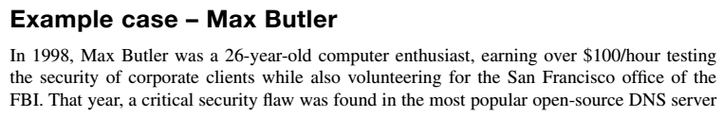

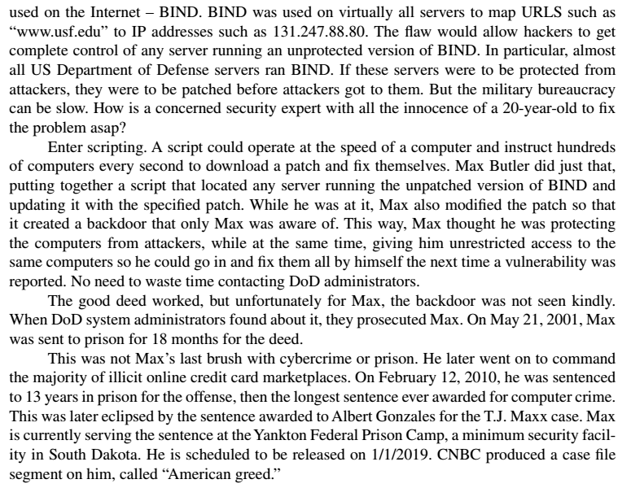
Example Case: Max Butler
https://en.wikipedia.org/wiki/Max_Butler

Slide 51
Example Case Questions
What were some establishments affected by Max Butler’s script?
Max Butler claims that he installed the backdoor on the affected computers as a benign move so that he could fix the computers in the future all by himself. How do you react to this claim, i.e., to what extent do you believe that this claim absolves him of guilt?

Slide 52
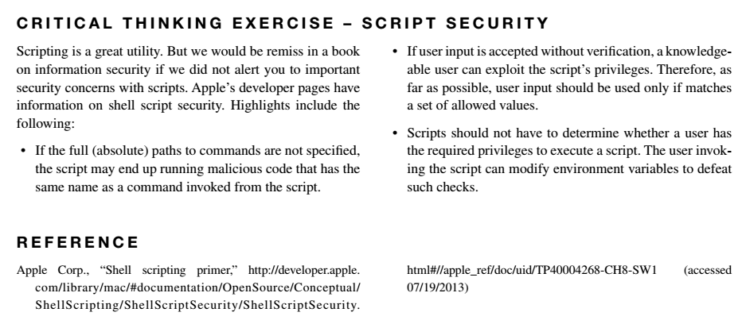
Critical Thinking Exercise

Slide 53
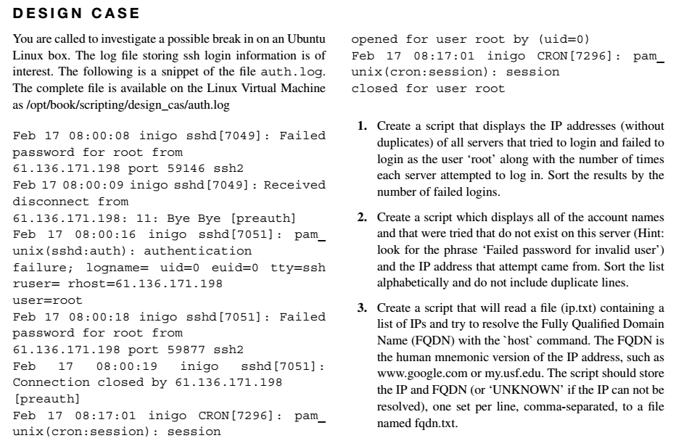
Design Case

Slide 54
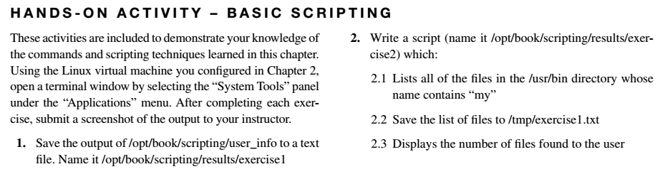
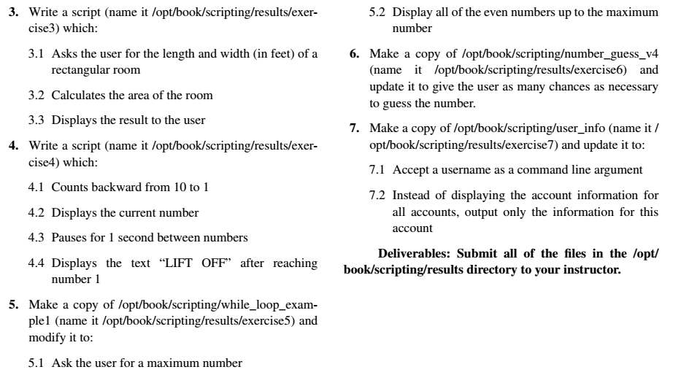
Hands-on Activity

Slide 55
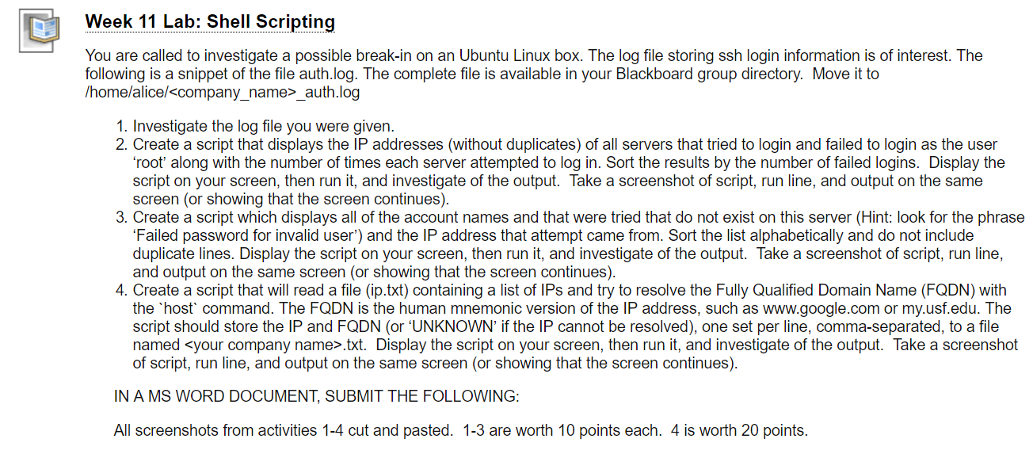
Homework Lab_11

Slide 56
Discussion 11
POST (due WED 11:59 pm CST): In last week’s Hands-On activity for Chapter 9 in our book, you installed the OSSEC vulnerability and intrusion detection system and triggered a few alerts. These alerts were logged in /var/ossec/logs/alerts/alerts.log . Suggest how you would write a script that parses /var/ossec/logs/alerts/alerts.log and displays the alert messages and their associated timestamps for an alert level that the user determines when calling the script (i.e. as input parameter). In your suggestion, provide as much code as possible.
RESPONSES (due FRI 11:59 pm CST): Respond to two of your peers and try out the ideas or the code they have posted. Would their ideas or code work? If not, how can you get it to work? Post your ideas for improvement.

Slide 57
Summary
How to write a simple BASH shell script
Use of common programming elements (variables, loops, etc)
How to handle user interaction
How to use common UNIX tools to parse and manipulate text files

Slide 58
For Next Week
# | Topic | Reading | Due 11:59 pm CST on Blackboard
12 | Incident Management: Incidents overview, Incident handling | Agrawal 11 Other materials on Blackboard | W: Post F: Responses S: LAB_12

